Slide 1
Warm-up!
Supply Check
Calculator
Pencil/Pen
3-Ring Binder
Notecards
Graph Paper
Ruler
Compass
Protractor
Scissors
Draw a point.
Give a real life example of a
point.
Draw a line.
Give a real life example of a
line.
Draw a plane.
Give a real life example of a
plane.

Slide 2
How to Login
From a desktop computer or a Chromebook:
Students in grades K-5 will go drive.google.com and login using their Google credentials (see below).
Email: StudentID@students.sd308.org
Password: what students login the district computer with

Slide 3
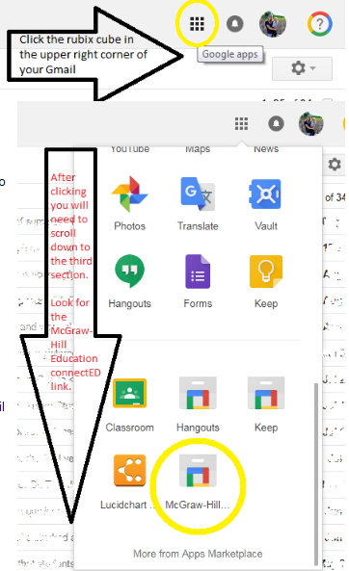

Slide 4
Warm-up!
Online
Exploration
Draw a point.
Give a real life example of a
point.
Draw a line.
Give a real life example of a
line.
Draw a plane.
Give a real life example of a
plane.
Were we able to log in?
What did we learn?

Slide 5
Honors Geometry
Today:
Chromebooks
1.1 Notes
Homework expectations.
Homework
Notes:
Only 1 problem on unit test from section 1.1
Honors Addition: Union and Intersection problems involving geometric figures

Slide 6
1.1 Points, Lines and Planes
Objective:
Identify and model points, lines, and planes
Identify intersecting lines and planes.
Vocabulary:
point, line, plane, collinear, coplanar, union*, intersection, definition, defined term, space

Slide 7
Undefined Term: items not defined by means of more basic words and concepts, but rather using examples or descriptions.
Point: a location with no dimensions. Usually represented by a dot and a capital letter.
A
pt A

Slide 8
Undefined Term: items not defined by means of more basic words and concepts, but rather using examples or description.
Line: made of points that extend in one dimension – no width or depth, but infinite length. 2 points determine a line.
l
A
B
line l

Slide 9
Undefined Term: items not defined by means of more basic words and concepts, but rather using examples or description.
Plane: made of points that extend infinitely in two directions, but has no height. A flat surface with no thickness. Three noncollinear points determine and name a plane. A capital script letter can also name a plane.
A
M
B
C
D

Slide 10
Defined Term: items defined by means of undefined terms or previously defined terms.
Collinear: points or other objects that all lie on one line.
C
D
A
B
D

Slide 11
Defined Term: items defined by means of undefined terms or previously defined terms.
Coplanar: points or other objects that all lie on one plane.
A
M
B
C
D

Slide 12
Defined Term: items defined by means of undefined terms or previously defined terms.
Triangle: a plane figure that is made by connecting three noncollinear points.
Notes:
Similar to problem on Term Exam

Slide 13
Defined Term: items not defined by means of basic words and concepts, but rather using examples or description.
Space: points that extend infinitely in all 3 dimensions. All points that we know. Determined by 4 noncoplanar points. No name since we only know of one.

Slide 14
Concept
Notes:
Everyone turn to page 5. This is what you should see. So if you are ever lost on definitions, here they are for you.

Slide 15
Example 6
What is this?

Slide 16
Example 6
What is this?

Slide 17
Example 6
What is this?

Slide 18
Example 6
What is this?

Slide 19
Example 6
What is this?

Slide 20
Example 6
What is this?

Slide 21
Example 6
What is this?

Slide 22
Example 6
What is this?

Slide 23
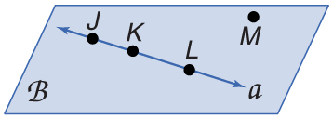
Example 1
EXAMPLE 1
A. Use the figure to name a line containing point K.
Answer: The line can be named as line a.
There are three points on the line. Any two of the points can be used to name the line.

Slide 24
Example 1
EXAMPLE 1
B. Use the figure to name a plane containing point L.
Answer: The plane can be named as plane B.
You can also use the letters of any three noncollinear points to name the plane. plane JKM plane KLM plane JLM
The letters of each of these names can be reordered to create other acceptable names for this plane. For example, JKM can also be written as JMK, MKJ, KJM, KMJ, and MJK. There are 15 different three-letter names for this plane.

Slide 25
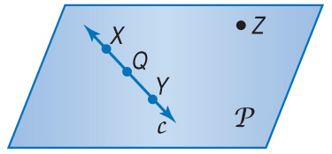
Example 1a
EXAMPLE 1
A. Use the figure to name a line containing the point X.
A. line X
B. line c
C. line Z
D.

Slide 26
EXAMPLE 1
B. Use the figure to name a plane containing point Z.
A. plane XY
B. plane c
C. plane XQY
D. plane P

Slide 27
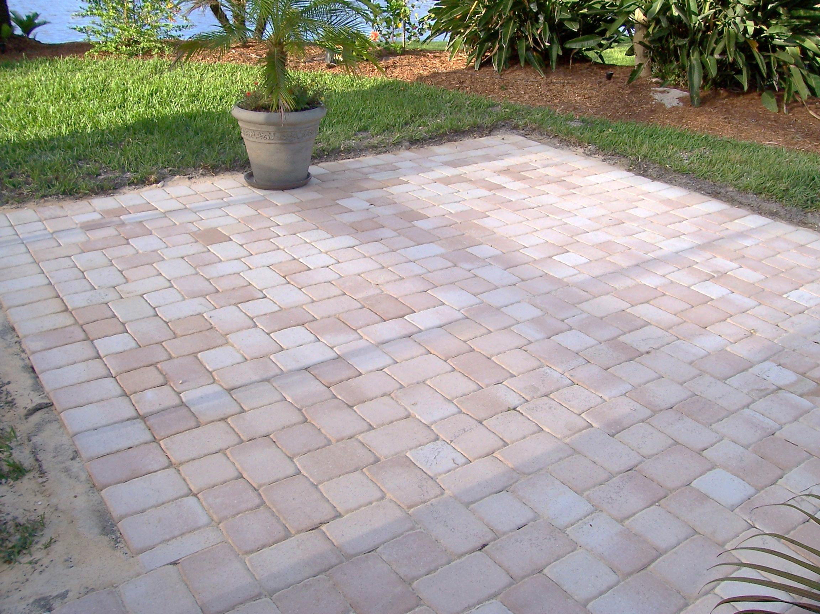
Example 2
1-1
Points, Lines, And Planes
LESSON
Real World EXAMPLE 2
A. Name the geometric shape modeled by a 10 × 12 patio.
Answer: The patio models a plane.

Slide 28
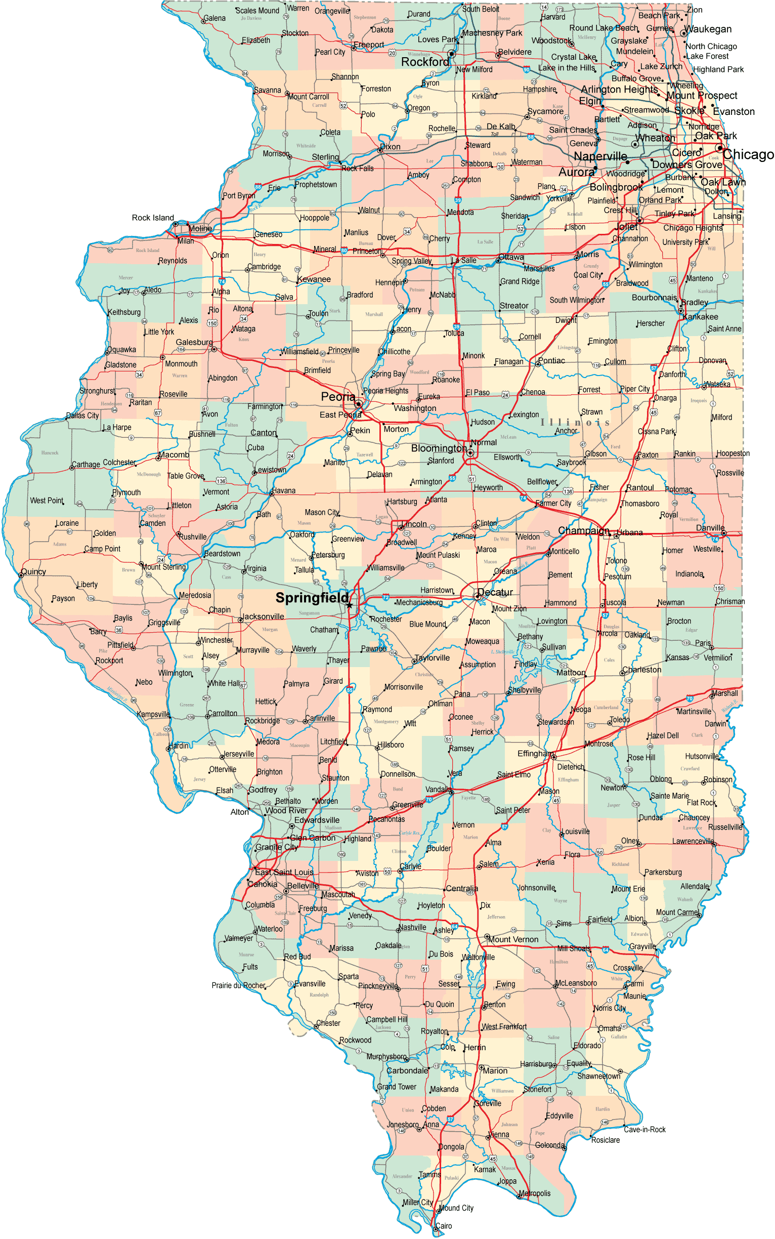
Example 2a
Real World EXAMPLE 2
A. Name the geometric shape modeled by a colored dot on a map used to mark the location of a city.
A. point
B. line segment
C. plane
D. none of the above

Slide 29
Example 3
EXAMPLE 3
Draw a surface to represent plane R and label it.

Slide 30
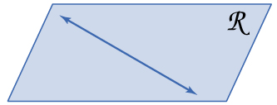
Example 3
EXAMPLE 3
Draw a line anywhere on the plane.

Slide 31
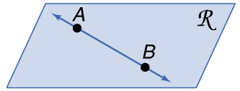
Example 3
EXAMPLE 3
Draw dots on the line for point A and B. Label the points.

Slide 32
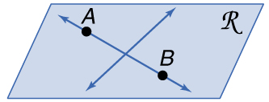
Example 3
EXAMPLE 3

Slide 33
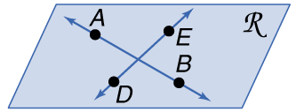
Example 3
EXAMPLE 3
Draw dots on this line for point D and E. Label the points.

Slide 34
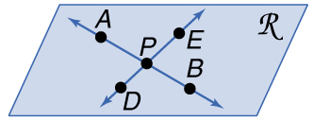
Example 3
EXAMPLE 3
Label the intersection point of the two lines as P.

Slide 35
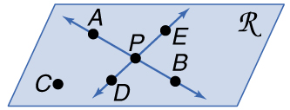
Example 3
EXAMPLE 3
Answer:

Slide 36
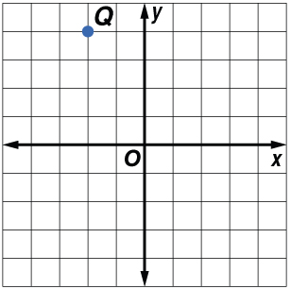
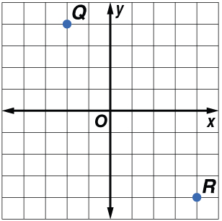
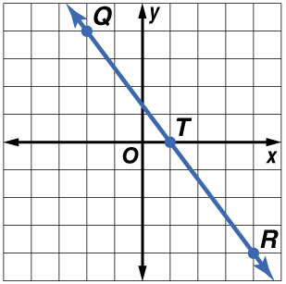
Example 3
EXAMPLE 3
Answer:
There are an infinite number of points that are collinear with Q and R. In the graph, one such point is T(1, 0).

Slide 37
Example 3b
EXAMPLE 3

Slide 38
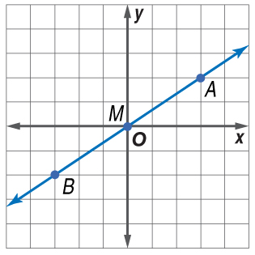
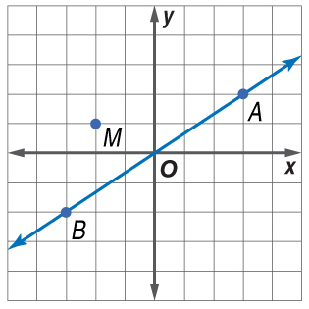
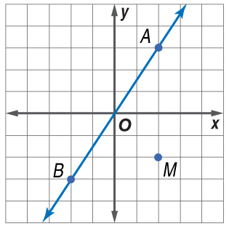
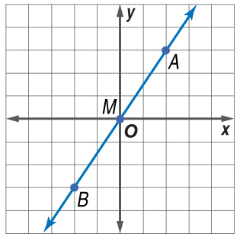
Example 3b
A. B.
C. D.

Slide 39
Expectations:
To be done in PENCIL!
Name, period, comment, and assignment at the top of the paper.
All work shown. This includes diagrams.
I expect you to check your answers at home on my webpage. (Correct you answers in a different color.)
I will grade a few problems for you to get credit.
Comment at the top in a different color.
Homework every night is worth 4 points.

Slide 40
Assignment
Finish online exploration worksheet
1.1 P. 8-12 #13-21, 32-38 even, 44-47
*Go to website for answers
Summary:
What are some statements to summarize what we have learned today?
Notes:
EC. E,N,T (Eight, Nine, Ten)

