Slide 1
Today:
Warm-up
Homework questions?
Collect homework
1.2 Instruction
Warm-up:
Name the intersection of plane Q and plane R.
2. Name a point that is noncoplanar to plane R.

Slide 2
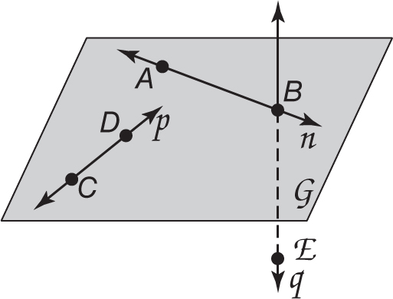
Today:
Warm-up
Homework questions?
Collect homework
1.2 Instruction
E

Slide 3
1.2 Linear Measure
Objective:
Measure segments.
Calculate with measures.
Vocabulary:
Line segment, betweeness of points, between, congruent segments, construction

Slide 4
line segment: a part of a line that consists of two endpoints and all the points in between those endpoints – also called a segment.
A
B
endpoints
measure: find the size of an object
The length of AB is represented with AB.

Slide 5
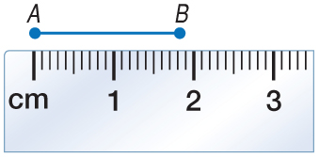
Example 1a
EXAMPLE 1
A. 2 mm
B. 1.8 mm
C. 18 mm
D. 20 mm

Slide 6
Example 2
EXAMPLE 2
A.

Slide 7
betweeness: a point is between 2 other points if it is on the segment created by the two points – all 3 points must be collinear.
E
A
B
C
D
F

Slide 8
Concept
A
B
C

Slide 9
Example 3
EXAMPLE 3
Find XZ. Assume that the figure is not drawn to scale.

Slide 10
Example 3
EXAMPLE 3
Find BD. Assume that the figure is not drawn to scale.
D
A. 16.8 mm
B. 57.4 mm
C. 67.2 mm
D. 84 mm
50.4 mm
16.8 mm
C
B

Slide 11
Example 4
EXAMPLE 4
Find LM. Assume that the figure is not drawn to scale.
Point M is between L and N.
LM + MN = LN Betweenness of points

Slide 12
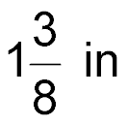
Example 4
EXAMPLE 4
Find TU. Assume that the figure is not drawn to scale.
3 in
V
in.
A.
B.
C.
D.
U
T
in.
in.
in.

Slide 13
Example 5
EXAMPLE 5
ALGEBRA Find the value of x and ST if T is between S and U, ST = 7x, SU = 45, and TU = 5x – 3.
CHECK ü
Answer: x = 4, ST = 28

Slide 14
Example 5
EXAMPLE 5
ALGEBRA Find the value of n and WX if W is between X and Y, WX = 6n – 10, XY = 17, and WY = 3n.
A. n = 3; WX = 8
B. n = 3; WX = 9
C. n = 9; WX = 27
D. n = 9; WX = 44
CHECK ü

Slide 15
Example 5
Honors Up!
EXAMPLE 5
ALGEBRA Find the value of x and AC if C is between A and B, AC = x² + 3, BC = x + 4, and AB = 49 in.
CHECK ü
Answer: x = 6, AC = 39”

Slide 16
congruent: items that are the same size and shape. Use the symbol .
=
means same size
means same shape
means same shape and size
~
~
=

Slide 17
Concept

Slide 18
Example 5
Honors Up!
EXAMPLE 6
ALGEBRA Find the value of x, y, and FE given:
E and F are between H and G
E is between F and G
HF = x + 2y, FE = x – y, EG = 3x – 3y, HG = 42’,
CHECK ü
Answer: x = 10, y = 4, FE = 6 ft

Slide 19
Example 6
Real World EXAMPLE 7
FONTS The Arial font is often used because it is easy to read. Study the word time shown in Arial type. Each letter can be broken into individual segments. The letter T has two segments, a short horizontal segment, and a longer vertical segment. Assume that all segments overlap where they meet. Which segments are congruent?
TIME
Answer: The five vertical segments in the letters T, I, M, and E are congruent. The four horizontal segments in T and E are congruent. The two diagonal segments in the letter M are congruent.

Slide 20
Homework!
Due tomorrow:
1.2 P. 18-21 #11-31every other odd, 40, 42, 43 & 1.2 more practice
*Go to website for answers

Slide 21
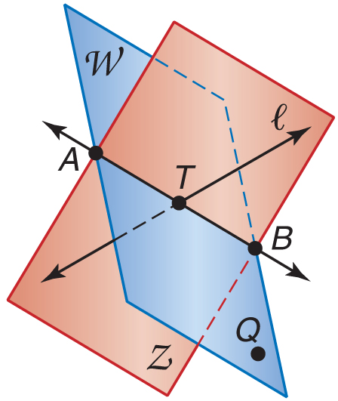
5-Minute Check 4
Over Lesson 1–1
Name the intersection of planes Z and W.
A. BZ
B. AW
C. AB
D. BQ

Slide 22
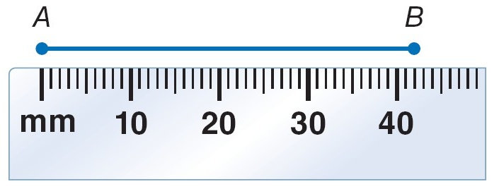
Example 1
EXAMPLE 1
A. Find the length of AB using the ruler.
Answer: AB is about 42 millimeters long.

Slide 23
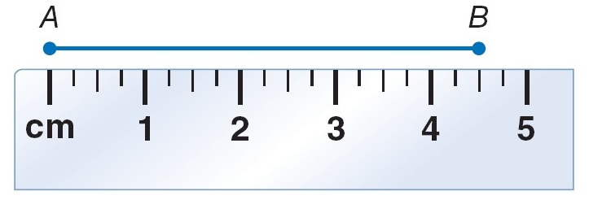
Example 1
EXAMPLE 1
B. Find the length of AB using the ruler.
Answer: AB is about 4.5 centimeters long.

Slide 24
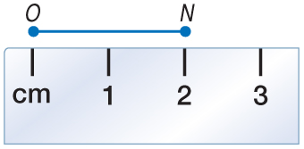
Example 1b
EXAMPLE 1
B.
A. 1 cm
B. 2 cm
C. 2.5 cm
D. 3 cm

Slide 25
Example 2
EXAMPLE 2
B.

