Slide 1
Honors Geometry
Warm-up:
There are points T, D, R, and Z. T and D are between R and Z. D is between T and Z. RD = 3x-3, DZ = 2x - 2,
RZ = 50, and . What is the length of .
Today:
Homework Questions?
1.3 Instruction
Homework
I can't change the direction of the wind, but I can adjust my sails to always reach my destination.
X = 11, TD = 15
Notes:
1 problem on the unit exam from this section – a midpoint problem
Honors Addition: segment addition problems involving quadratics and systems

Slide 2
1.3 Distance and Midpoints
Objective:
Find the distance between two points.
Find the midpoint of a segment.
Vocabulary:
Distance, irrational number, midpoint, segment bisector

Slide 3
Distance between 2 points: the length of the line segment with those points as the endpoints

Slide 4
Ruler Postulate:
Any point on a line can be matched to a real number
A
C
B
4.3
5.2
6.8
Find AB
Find BC
Find CA
2.5 u
1.6 u
0.9 u

Slide 5
Ruler Postulate:
Any point on a line can be matched to a real number
A
C
B
4.3
5.2
6.8

Slide 6
EXAMPLE 2
Find the distance between points A and B.
12
B(7, 8)
5
A(-5, 3)
9.5

Slide 7
EXAMPLE 2
Find the distance between points A and B.
R(-5, 8)
12
15
S(10, -4)
9.5

Slide 8
If P(x₁, y₁) and Q(x₂, y₂) are any two points, then the distance between them can be found with the formula .
Cool Tip #3:

Slide 9
EXAMPLE 2
Find the distance between points A and B.
A
(-3, 7)
(9, -2)
B
9.5

Slide 10
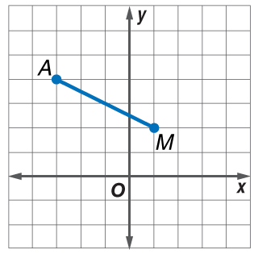
EXAMPLE 2
Find the distance between A(–3, 4) and M(1, 2).
A. 4 u
B. u
C. u
D.
9.5

Slide 11
midpoint: the point halfway between the endpoints of a segment.
midpoint:
EXAMPLE 3
M
Use the number line to find the midpoint of AX.
-1

Slide 12
EXAMPLE 3
Find the midpoint M of a segment on the number line with endpoints R = -20 and S = 33.
M = 6.5u

Slide 13
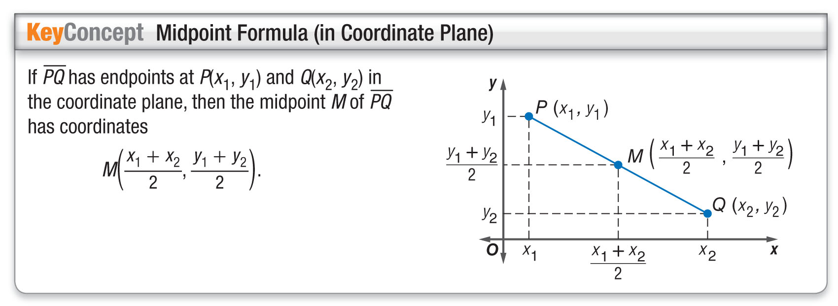
EXAMPLE 4
Find the midpoint M of a segment with endpoints F(4, 12) and G(8, 6).
M(6, 9)

Slide 14
EXAMPLE 4
Answer: (–3, 3)
Example 4

Slide 15
EXAMPLE 5
Cool Tip #4:
Endpoint (A , B)
Midpoint (C , D)
Endpoint (? , ?)
Answer: The coordinates of D are (–7, 11).
Example 4

Slide 16
EXAMPLE 5
Find the coordinates of R if N (8, –3) is the midpoint of RS and S has coordinates (–1, 5).
A. (3.5, 1)
B. (–10, 13)
C. (15, –1)
D. (17, –11)
Example 4

Slide 17
Example 5
Honors Up!
EXAMPLE 5
Find the 2nd endpoint if the midpoint is (120,-98) and the 1st endpoint is (-312, 21).
CHECK ü
Answer: endpoint (552, -217)

Slide 18
Example 5
Honors Up!
EXAMPLE 5
Find the midpoint and distance of the segment with endpoints: (12,-11) and (24, 5)
CHECK ?
Answer: Midpoint (18, -3) dist = 20 u

Slide 19
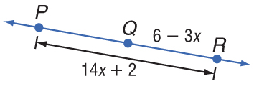
Example 6
EXAMPLE 6

Slide 20
Example 6
EXAMPLE 6
A. 1
B. 10
C. 5
D. 3
ANSWER: AC = 10
Take the answer and
check on your own time.

Slide 21
Example 5
Honors Up!
EXAMPLE 6
Given that M is the midpoint of AB and that AM = 2x + 5y, BM = 52’, and AB = 10x + 10y + 24, find the values of x, y and AB.
Answer: (-4, 12) AB = 104 u
CHECK ü

Slide 22
Example 5
Honors Up!
EXAMPLE 6
Points B and C are the trisection points of AD.
If AB = x² + 4x and BC = 2x², find the value of x and AC.
CHECK ü
Answer: x = 4, AC = 64 u
Notes:
The second answer comes from when the points are A – C – B – D.

Slide 23
Assignment
Due tomorrow:
1.3 P. 31-33
# 24, 45, 47, 56 & 1.3 More Practice
*Go to website for answers
I can't change the direction of the wind, but I can adjust my sails to always reach my destination.
Jimmy Dean

