Slide 1
Honors Geometry
WARM-UP!
Today:
Homework questions?
Review 1.3
Start 1.4
QUIZ Friday!
Find the midpoint and distance of the segment with endpoints: (12,-11) and (24, 5)
Answer: Midpoint (18, -3) dist = 20 u
Notes:
No problems on the unit exam directly from this
Honors Addition: angle addition problems involving quadratics and systems, breaking down angle measures to degrees, minutes, seconds.

Slide 2
Example 5
Honors Up!
EXAMPLE 6
Given that M is the midpoint of AB and that AM = 2x + 5y, BM = 52’, and AB = 10x + 10y + 24, find the values of x, y and AB.
Answer: (-4, 12) AB = 104 u
CHECK ü

Slide 3
Example 5
Honors Up!
EXAMPLE 6
Points B and C are the trisection points of AD.
If AB = x² + 4x and BC = 2x², find the value of x and AC.
Extra algebra test point
if you do this on a separate sheet and hand it in to me before Friday!
Notes:
The second answer comes from when the points are A – C – B – D.

Slide 4
1.4 Angle Measure
Objective:
Measure and classify angles.
Identify and use congruent angles and the bisector of an angle.
Vocabulary:
ray, opposite rays, angle side, vertex, interior, exterior, degree, right angle, acute angle, obtuse angle, angle bisector

Slide 5
ray: part of a line that consists of a point, called the initial point, and all points on a line that extend in one direction from the initial point.
A
B
initial point

Slide 6
ray: part of a line that consists of a point, called the initial point, and all points on a line that extend in one direction from the initial point.
A
B

Slide 7
Angle: made from two different rays that have the same initial point. The rays are the sides of the angle. The initial point is the vertex of the angle.
YXZ or ZXY or X
Y
sides
1
1
X
Z
vertex

Slide 8
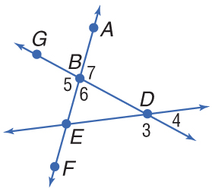
EXAMPLE 1
A. Name all angles that have B as a vertex.
Answer:
B. Name the sides of ∠5.
Answer:
C.
Example 1

Slide 9
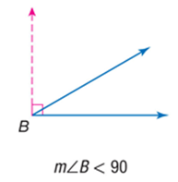
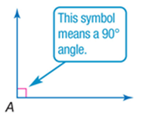
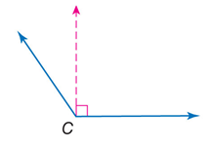
Classify Angles
acute angle –
right angle –
obtuse angle –
straight angle –

Slide 10
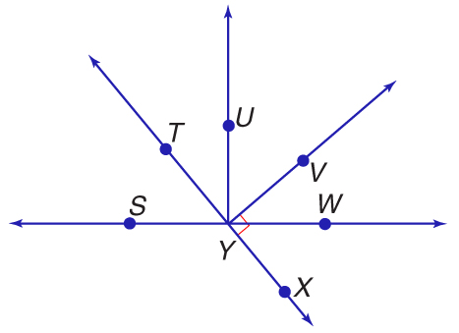
EXAMPLE 2
Name All:
Right Angles:
Acute Angles:
Obtuse Angles:
Straight Angles:
VYX and VYT
SYT, TYU, UYV, VYW, WYX
SYX, XYU, WYT, VYS
TYX, SYW

Slide 11
EXAMPLE 3
1
2
Find x.
can’t be done
x = 8

Slide 12
EXAMPLE 2
2
1
3
Find all angles.

Slide 13
EXAMPLE 4
2.4 < x < 20.4

Slide 14
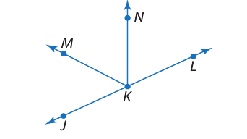
EXAMPLE 5
Honors Up!- Write at the
bottom of your page
46➢

Slide 15
Find m∠BHC and m∠DJE if ∠BHC ≅ ∠DJE, m∠BHC = 4x + 5, and m∠DJE = 3x + 30.
Answer: m∠BHC = 105, m∠DJE = 105

Slide 16
Exit Slip
The m∠ABC = 64⁰. Point D is in the interior of ∠ABC such that m∠ABD = $x^{2}$-4x and m∠DBC =-8x. Find the value of x and the measure of all the missing angles.

Slide 17
Example 5
Honors Up!
EXAMPLE 5
60 minutes = 1 degree
60 seconds = 1 minute

Slide 18
Honors Up!
EXAMPLE 5
60 minutes = 1 degree
60 seconds = 1 minute

Slide 19
Assignment
Due Tomorrow:
1.4 P. 41-42 #13-29Every Other Odd, 39 & 1.4 Extra Practice
*Go to website for answers
QUIZ Friday!

